Slide 1
Samples _ Nov 2019
6 Helix samples
3 Plasmonic samples (SLR)
3 Metasurface samples

Slide 2
Helix Samples (6)
Sample ITO 150 nm Pt3 (scattering, possibly interaction with nanoparticles)
Sample ITO 20 nm Pt 2 (scattering, possibly interaction with nanoparticles)
Sample ITO 20 nm + Polymer (scattering, to be comperaed with )
Sample ITO 20 nm Pt1 (scattering, possibly integration with nanoparticles): lower quality, use for tests
Sample ITO 150nm+Au+Helices+nanodiamonds: PL mapping, lifetime mapping
Sample Si (NL experiments, scattering)

Slide 3
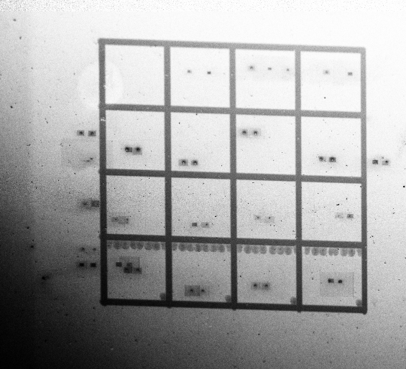
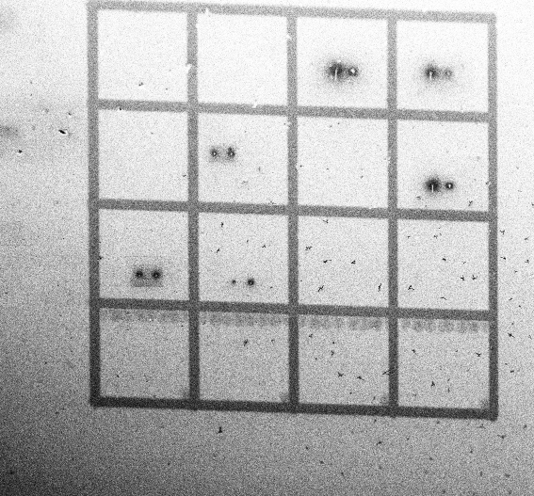
1) Sample ITO 150 nm Pt3 2 grids of enantiomer couples
Grid 1 Triple wire Helices
Grid 2 Single wire Helices + Pillars
D
D
Pillars
C
C
L
R
N=2
B
L
R
B
N=1/2
A
A
N=1
1
2
3
4
0
1
2
3
4

Slide 4
Name | N | Total Height (nm) | VP nm
A-0 | 0.5 | 320R-338L | 640-680
B-0 | 1 | 760R-850L | 760-850
C-0 | 1 | 340R-340L | 340-340
A-1 | 1 | 560R-580L | 560-580
B-1 | 0.5 | 200R-200L | 400-400
C-1 | 2 | 790R-770L | 395-385
A-2 | 1 | 800-800 | 800-800
B-2 | 0.5 | 340R-370L | 680-740
C-2 | 2 | 1340R-1350L | 670-675
D-2 | pillar | 220-330
A-3 | 1 | 580R-600L | 580-600
B-3 | 0.5 | 300R-310L | 600-620
C-3 | 2 | 1100R-1100L | 550-550
D-3 | pillar | 910-200-1200
A-4 | 1 | 350R-320L | 350-320
B-4 | 0.5 | 230R-260L | 460-520
C-4 | 2 | 730R-720L | 365-360
D-4 | pillar | 510-750

Slide 5
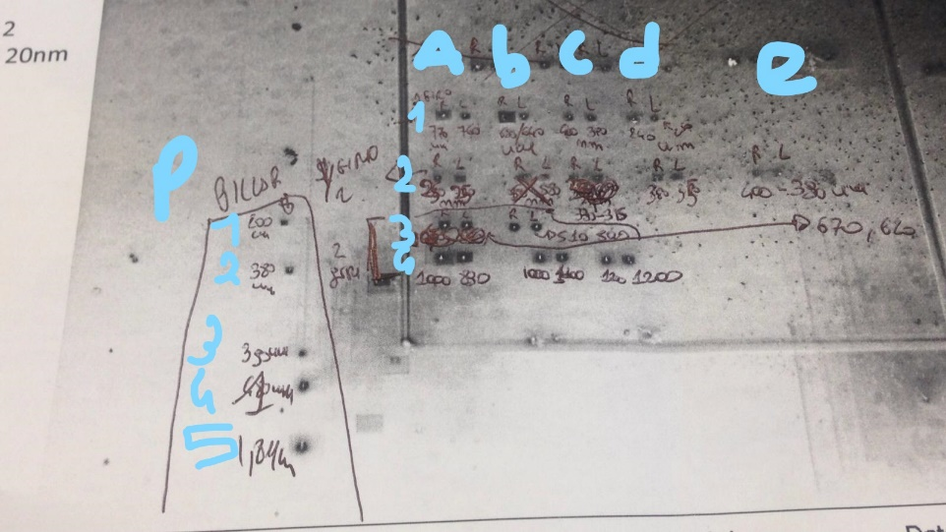
2) Sample ITO 20 nm Pt2 1 grid of enantiomer couples

Slide 6
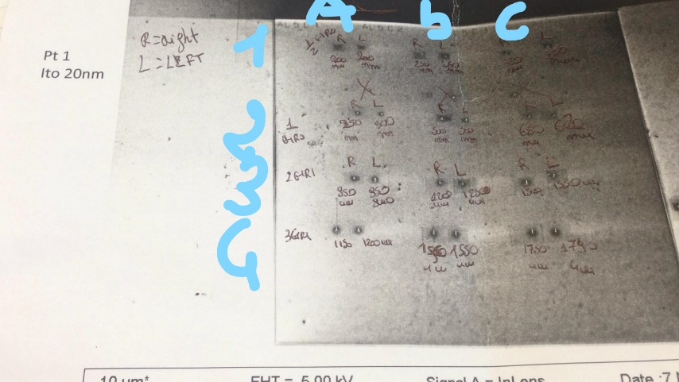
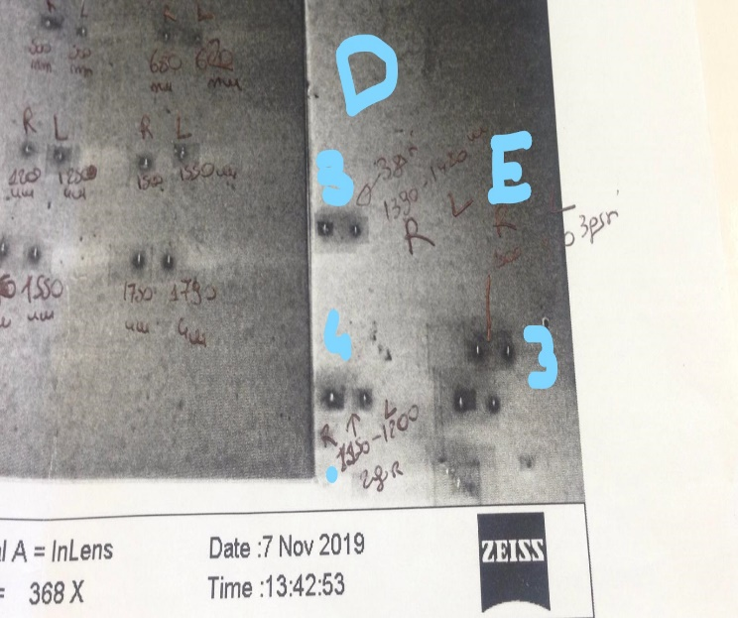
3)Sample ITO 20 nm Pt1+OPD 1 grid of enantiomer couples

Slide 7
4) Sample ITO 20 nm Pt1 plus deposit small arrays (ARRAY 3X3 ENANTIOMERS)
R
L
R
L
R
L

Slide 8
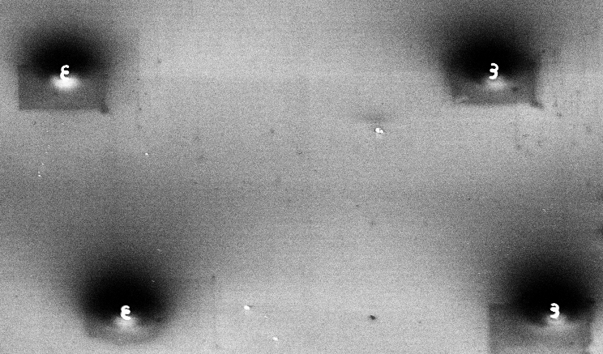
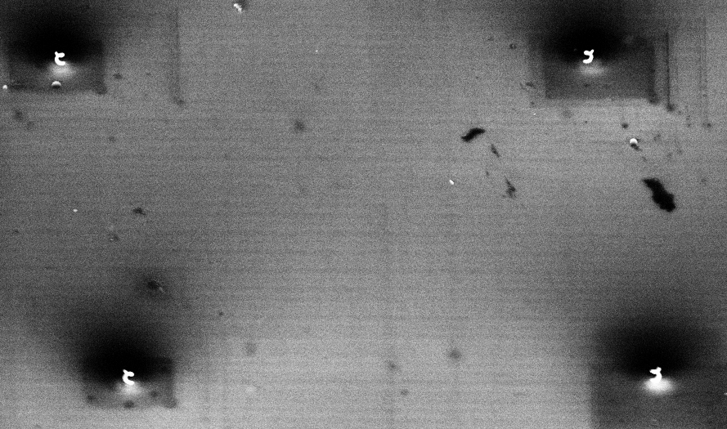
5) Sample Si with single helices in couple, with increasing loop number, same sizes
A
B
C
D
1
2
nothing
2
1.5
Name | N | Total Height (nm) | VP nm
A-1 | 0.5 | 290R-270L | 480-440
B-1 | 0.5 | 300R-290L | 600-580
C-1 | 0.5 | 320R-350L | 640-700
D-1 | 0.5 | 350R-350L | 700-700
A-2 | 1 | 410R-430L | 410-430
B-2 | 1 | 390R-430L | 390-430
C-2 | 1 | 430R-430L | 430-430
D-2 | 1 | 440R-420L | 440-420
A-3 | 1.5 | 740R-740L | 490-490
B-3 | 1.5 | 750R-760R | 500-505
C-3 | 1.5 | 720R-680L | 480-450
D-3 | 1.5 | 640R-640L | 430-430
A-4 | 2 | 820R-800L | 410-400
B-4 | 2 | 780R-780R | 390-390
C-4 | 2 | 770R-770R | 385-385
D-4 | 2 | 820R-740L | 410-370
3
0.5
4

Slide 9
6) Sample ITO 150 + Gold+ Nanodiamonds on helix array

Slide 10
Plasmonic Samples with Surface Lattice Resonances (3)
Aluminum
Quad2019: Non linear measurements
Mezze Lune 5: Non linear measurements
Mezze Lune 6: Non linera meaurements

Slide 11
1) Quad2019
80nm
0nm
20nm
40nm
20nm
Period:490nm
Period:490nm
Period:490nm
60nm
80nm
100nm
Period:490nm
Period:490nm
Period:490nm

Slide 12
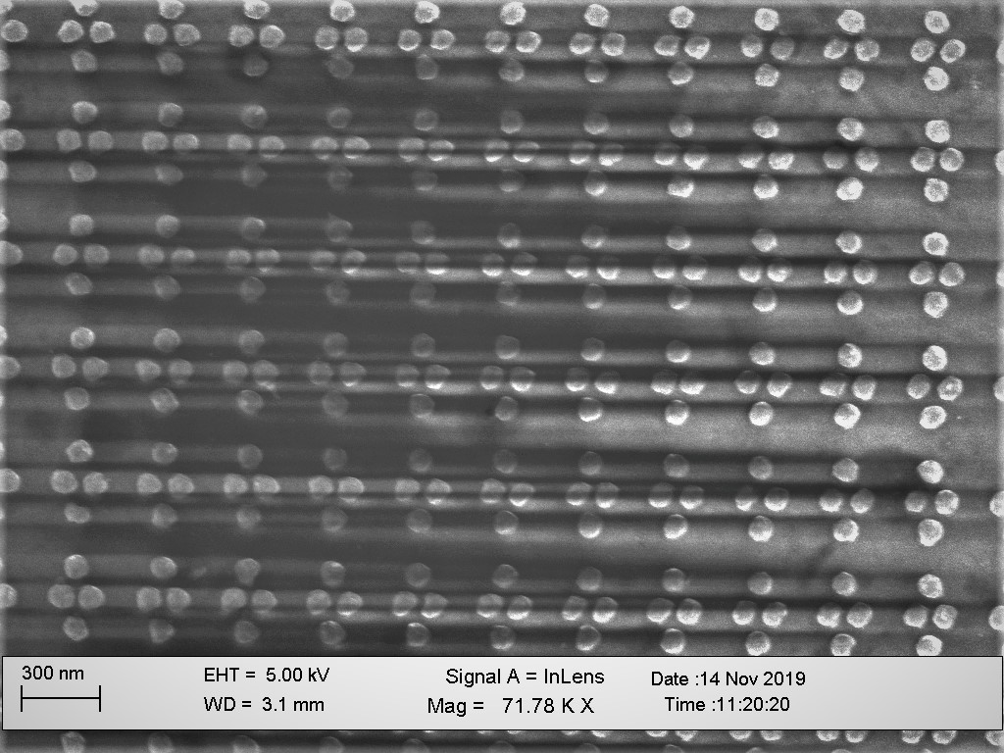
490nm

Slide 13
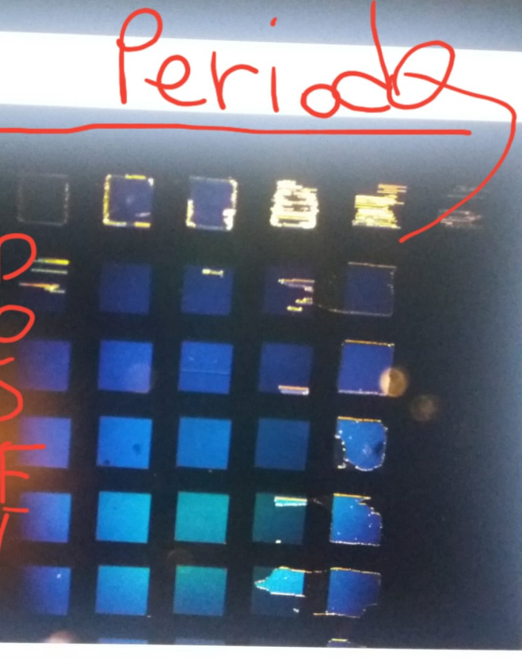
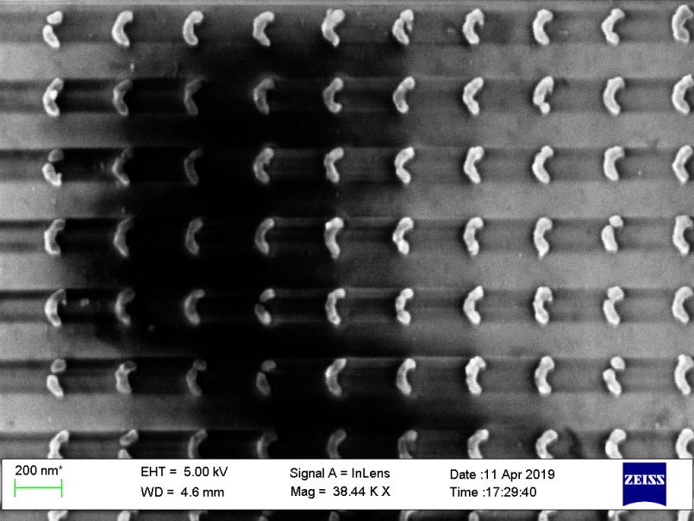
2) Mezze Lune
350
Periodicities:
350,370,390,410,
430,450
430
450

Slide 14
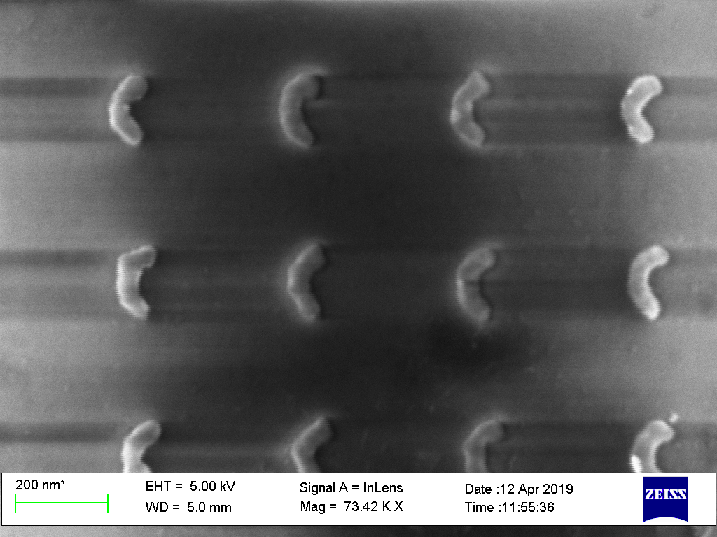
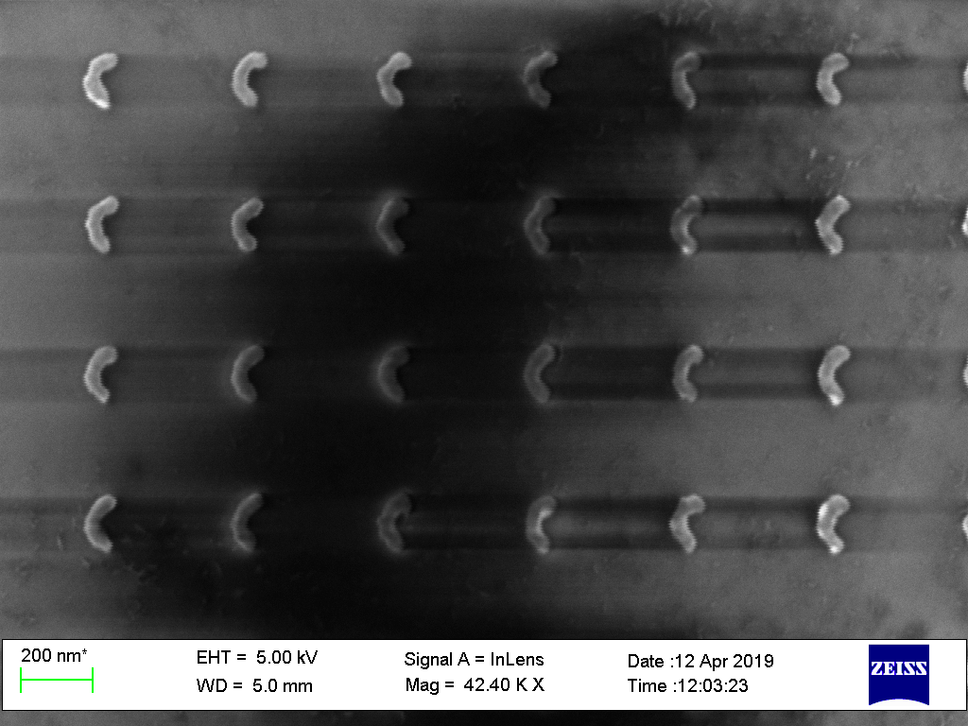
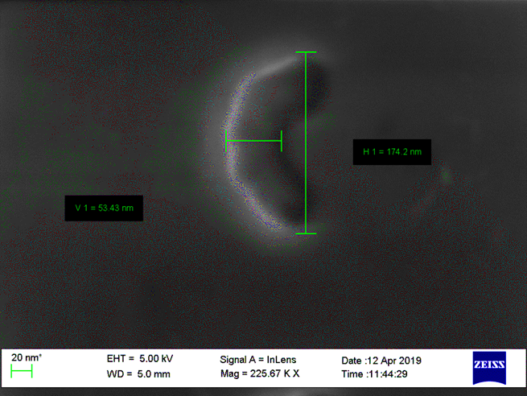
Period:350nm
Period:370nm
Period:390nm
Period:430nm
Period:450nm
Period:410nm

Slide 15
Au+Si Metasurfaces Samples(3)

Slide 16
Au+Si Metasurfaces Samples(3)
x
x
x
d=40nm g=40nm
ROW 3
x
d=60nm g=40nm
ROW 2
ROW 1
d=80nm g=40nm
d= diameter of each nanostracture
g= gab between each structure
X = don’t measure it!

